Slide 1

2023 California Medicaid Analysis

Slide 2

Overview
Introduction to Medi-Cal
Utilization
Reimbursement
Metrics

Slide 3

Medicaid & Medi-Cal

Slide 4
What is Medi-CAL?
Medi-Cal is California's Medicaid health care program. This program pays for various medical services for children and adults with limited income and resources. Medi-Cal is supported by Federal and state taxes. Medi-Cal is a large program comprising many programs designed to assist Californians in various family and medical situations.
Who’s elligibile?
Those who are pregnant
Have dependents under the age of 21
Have a disability or a family member in your household with a disability
Be 65 years of age or older.

Slide 5

Utilization

Slide 6
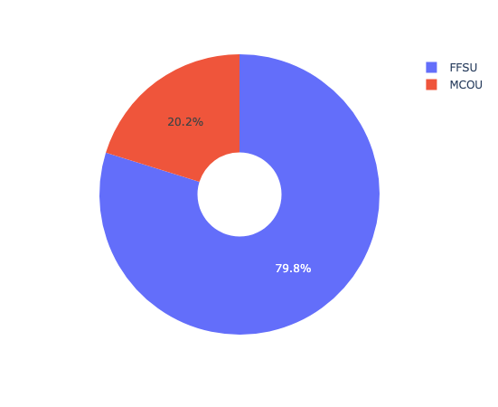
Utilization
Types
Fee-For-Service Utilization (FFSU)
A method in which doctors and other health care providers are paid for each service performed
Example: doctor visits and tests
Managed Care Organization Utilization(MCOU)
A health plan or health care company that utilizes managed care as its model to keep the quality of care high while limiting costs.
Example: insurance company or health plan

Slide 7

Utilization
How to define which prescriptions get utilization types?
Drug utilization review (DUR)
Defined as an authorized, ongoing review of prescribing, dispensing and use of medication. DUR encompasses a drug review against predetermined criteria that results in changes to drug therapy when these criteria are not met.
This Photo by Unknown Author is licensed under CC BY-NC

Slide 8

Reimbursement

Slide 9
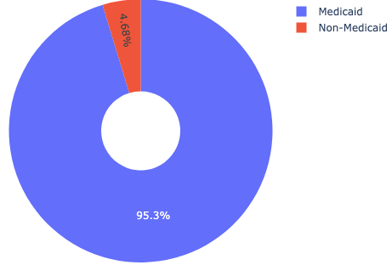
Reimbursement
Definition
The action of repaying a person who has spent or lost money.
95% of Prescriptions are covered by Med-Cal

Slide 10

Metrics
This Photo by Unknown Author is licensed under CC BY-SA

Slide 11
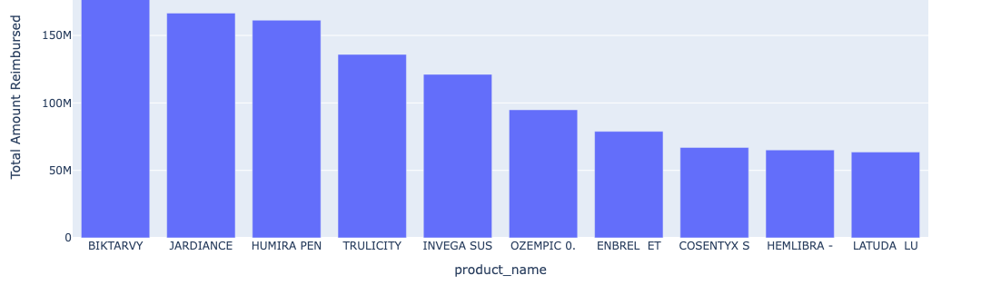
Top 10 Reimbursed Prescriptions

Slide 12
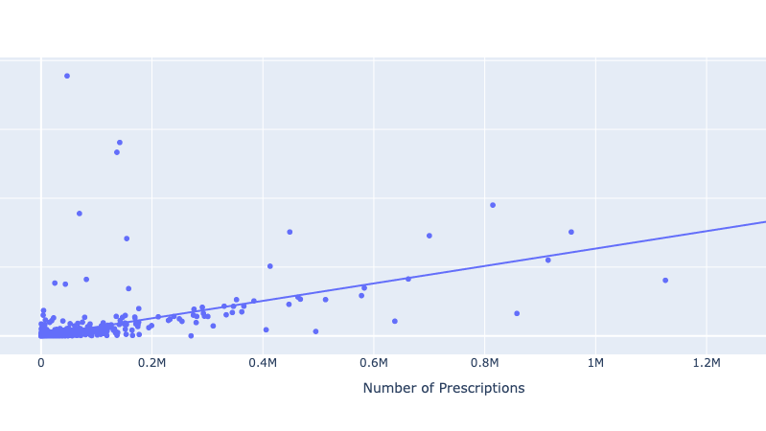
Number of Prescriptions vs. Units Reimbursed

Slide 13
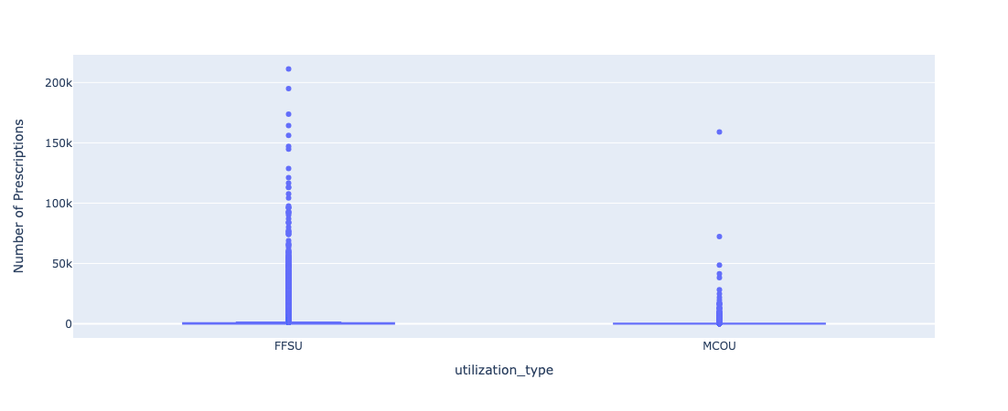
Number of Prescriptions & Utilization TYpe

